Slide 1
Classification
Module 4

Slide 2
Classification
Classification is the task of assigning objects to one of several predefined categories
Eg: determining spam email messages based upon the message header and content
Classifying galaxies based upon their shapes

Slide 3
Examples
A bank loan officer wants to analyze the data in order to know which customer are risky or safe(loan applicant)
A marketing manager at a company needs to analyze a customer with a given profile, who will buy a computer or not

Slide 4
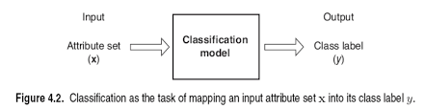
Classification- Definition
Classification is a task of learning a target function f that maps each attribute set x to one of the predefined class labels y

Slide 5
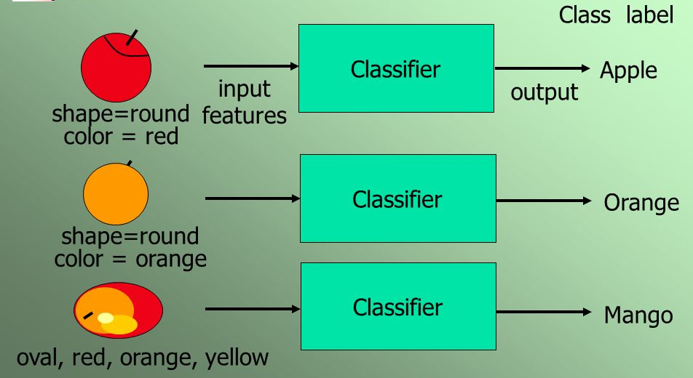

Slide 6
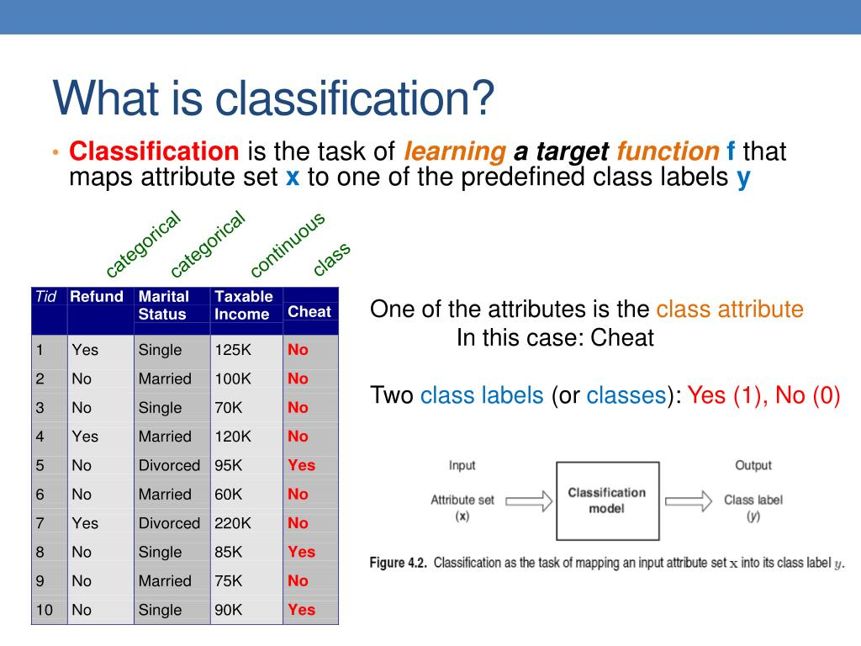

Slide 7
A classification model is useful for the following purposes:
Descriptive modeling
Predictive Modeling

Slide 8
Descriptive modeling
A classification model can serve as an explanatory tool to distinguish between objects of different classes

Slide 9
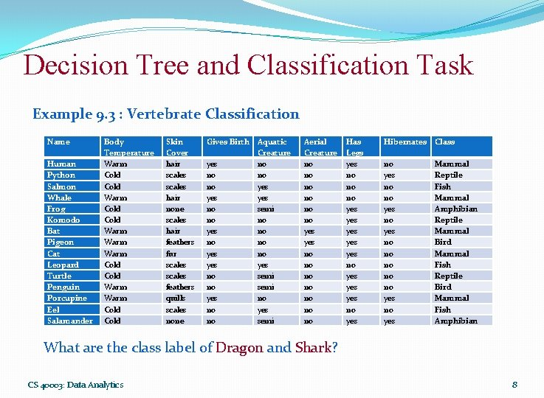

Slide 10
Predictive modeling
A classification model can also be used to predict the class label of unknown records

Slide 11
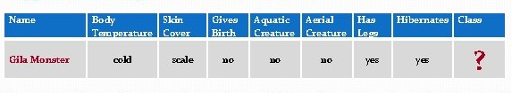

Slide 12
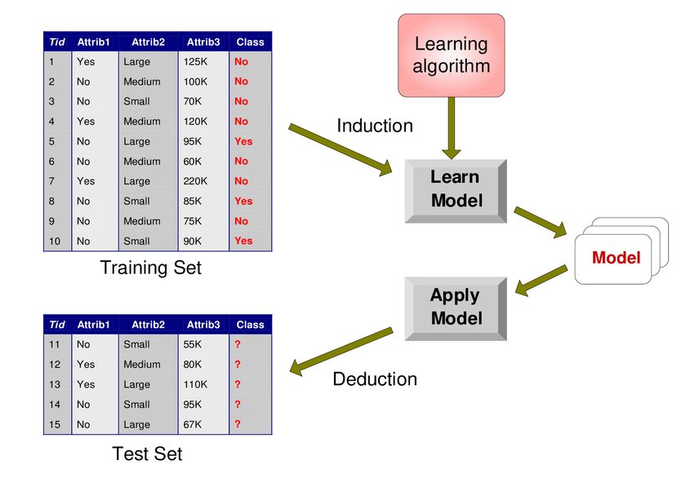
Illustration of Classification model

Slide 13
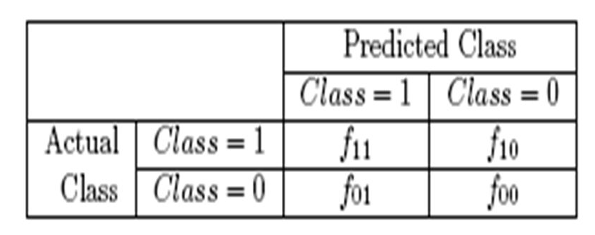
Confusion matrix
A table used to describe the performance of the classification model on as set of test data for which the true values are known

Slide 14
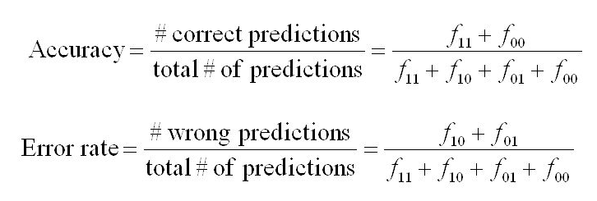

Slide 15
Actual \ Predicted | Pass | Fail
Pass | 8 | 2
Fail | 3 | 7

Slide 16
Actual \ Predicted | Pass | Fail
Pass | 8 | 2
Fail | 3 | 7
Accuracy = 75%
Error rate=25%

Slide 17
Types of Classifiers
Decision tree classifier
Rule based classifier
Nearest Neighbor classifier
Bayesian Classifier

Slide 18
Decision Tree Induction
A decision tree performs the classification in the form of a tree structure
The tree has three types of nodes:
Root node
Internal nodes
Leaf or terminal nodes

Slide 20
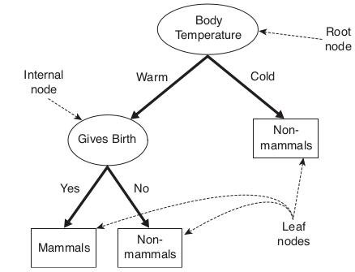

Slide 21
Root node: Has no incoming edges and zero or more outgoing edges
Internal node: each of which has exactly one incoming edge and two or more outgoing edges
Leaf or terminal nodes: each of which has exactly one incoming edge and no outgoing edges

Slide 22
Each leaf node is assigned a class label
Non terminal nodes(root or internal nodes) contains attribute test condition

Slide 23
How to build a decision tree
Many decision trees can be constructed from a given set of attributes
Some of the trees are more accurate than others
Hunts algorithm can be used

Slide 24
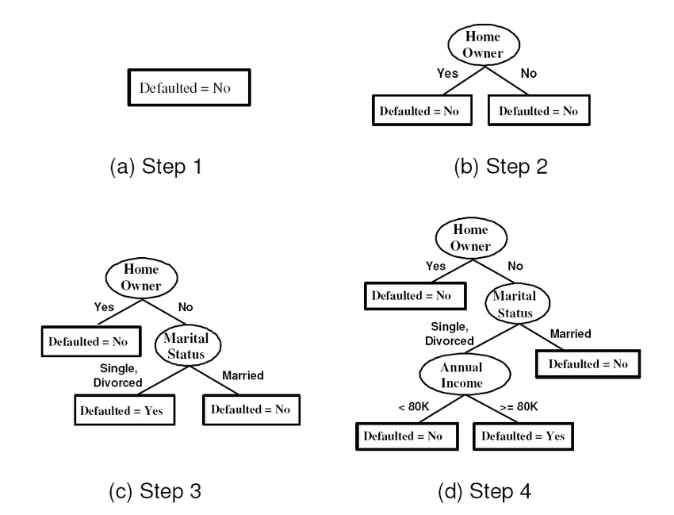
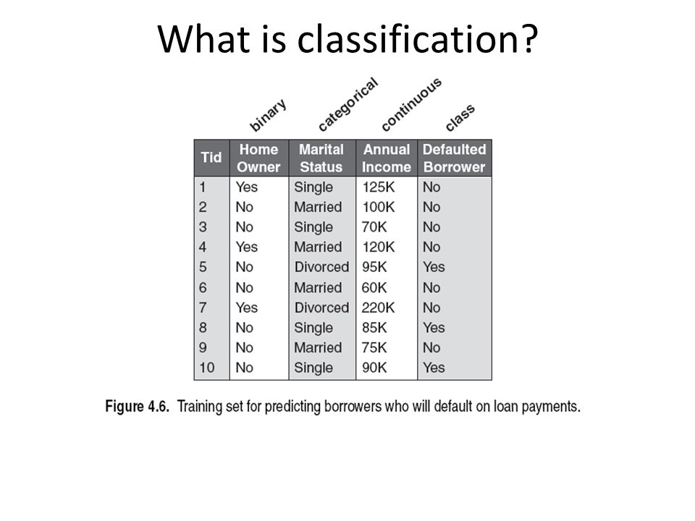

Slide 25
Student | Attendance | Study Hours | Internal Marks | Result
S1 | Good | High | High | Pass
S2 | Good | High | High | Pass
S3 | Poor | High | High | Pass
S4 | Good | Low | Low | Pass
S5 | Poor | Low | Low | Fail
S6 | Poor | Low | Low | Fail
S7 | Good | High | Low | Pass
S8 | Good | Low | High | Pass
S9 | Poor | High | Low | Fail
S10 | Poor | Low | High | Fail

Slide 26
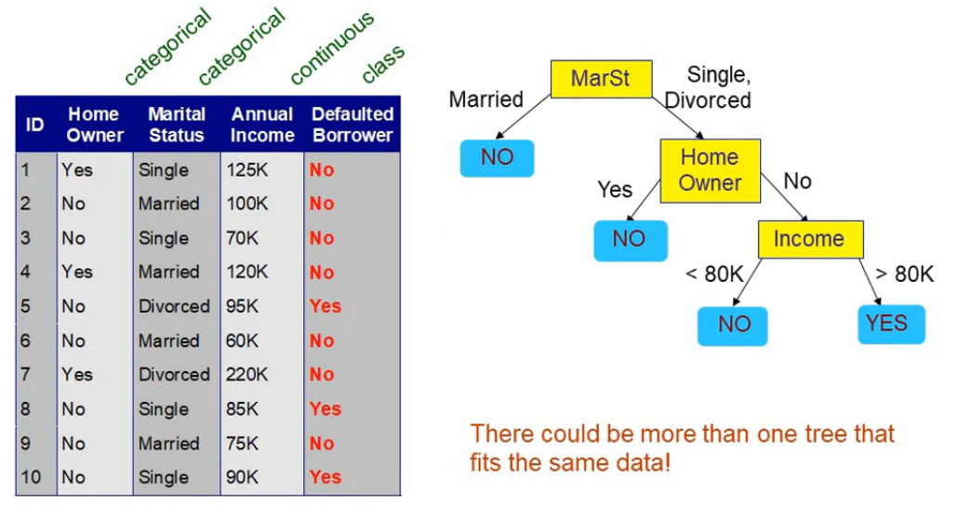

Slide 27
How a decision tree works

Slide 28
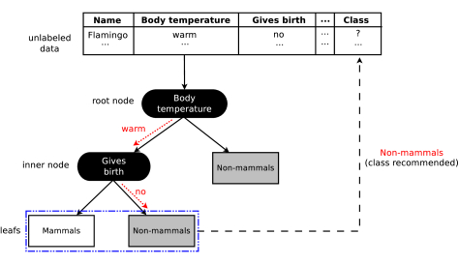

Slide 30
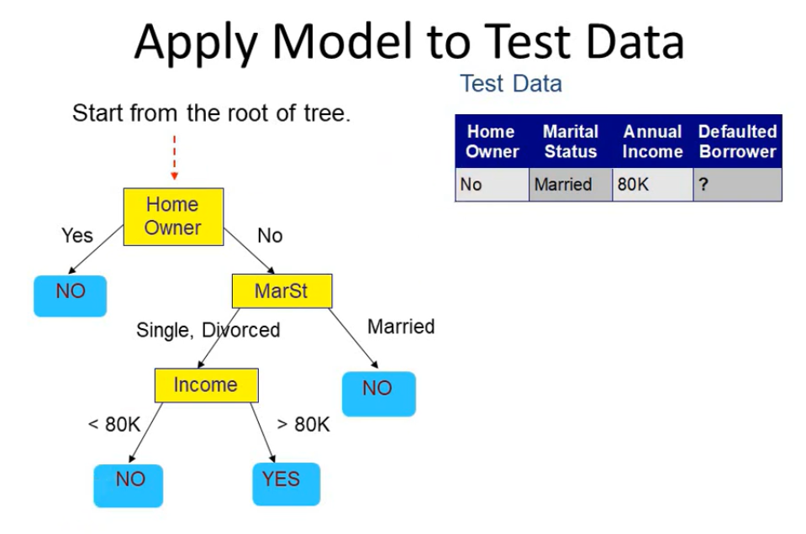

Slide 31
Hunts Algorithm
Hunts algorithm grows a decision tree in a recursive fashion by partitioning the training records into successively purer subsets

Slide 32
Let Dt be the set of training records that reach a node t
-If Dt contains records that belong the same class yt , then t is a leaf node labeled as yt
-If Dt contains records that belong to more than one class, use an attribute test to split the data into smaller subsets. Recursively apply the procedure to each subset

Slide 33
Decision tree induction algorithm must provide a method for expressing an attribute test condition and its corresponding outcomes for different attributes types.

Slide 34
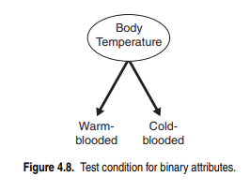
Binary Attribute

Slide 35
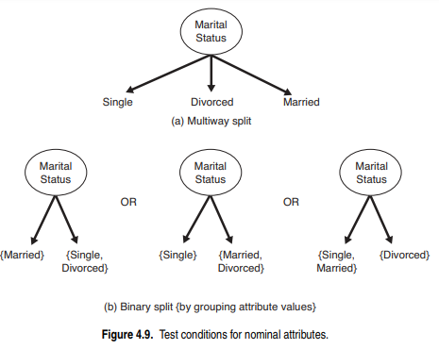
Nominal Attribute

Slide 36
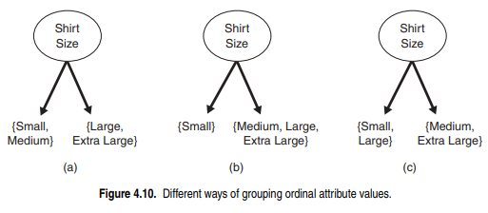
Ordinal Attribute

Slide 37
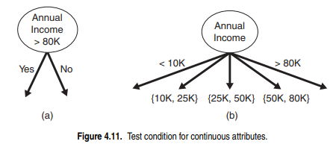
Continuous Attributes

Slide 38
Characteristics of decision tree induction
Decision tree induction is a non-parametric approach for building classification models
Finding an optimal decision tree is an NP-complete problem. Many decision tree algorithms employ a heuristic-based approach to guide their search in the vast hypothesis space.
Techniques developed for constructing decision trees are computationally inexpensive, making it possible to quickly construct models even when the training set size is very large.

Slide 39
Decision trees, especially smaller-sized trees, are relatively easy to interpret.
Decision trees provide an expressive representation for learning discrete-valued functions.
Decision tree algorithms are quite robust to the presence of noise, especially when methods for avoiding over-fitting.
The presence of redundant attributes does not adversely affect the accuracy of decision trees

Slide 40
Since most decision tree algorithms employ a top-down, recursive partitioning approach, the number of records becomes smaller as we traverse down the tree.
These algorithm usually employ a greedy strategy that grows a decision tree by making a series of locally optimum decisions about which attribute to use for partitioning the data
Many Algorithms:
-Hunts Algorithm
-CART
-ID3, C4.5
-SLIQ, SPRINT

Slide 41
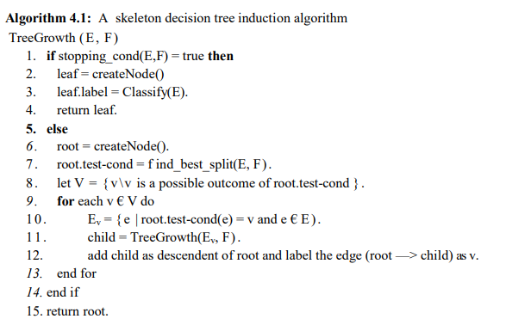

Slide 44
Measures for selecting the best split
There are many measures that can be used to determine the best way to split the records
The measures developed for selecting the best split are often based on the degree of impurity of the child node.

Slide 46
P(i|t)- denote the fraction of records belonging to class i at a given node t.

Slide 47
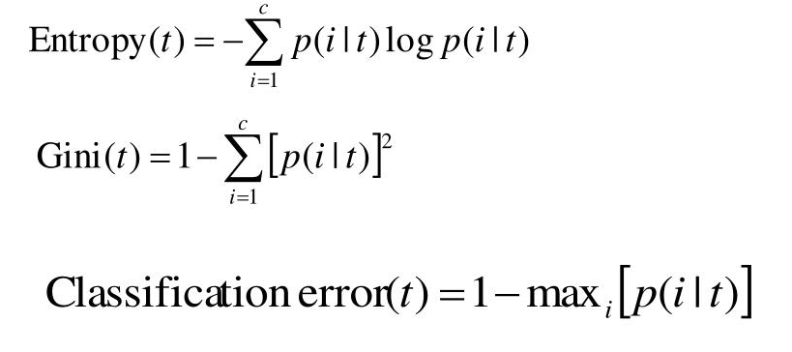
Example of impurity measures

Slide 48
Where c is the number of classes
0 log 0 =0 in entropy calculations

Slide 49
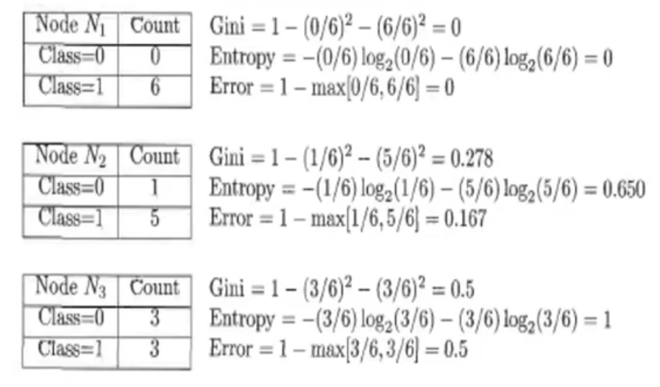

Slide 50
Example of impurity measures

Slide 51
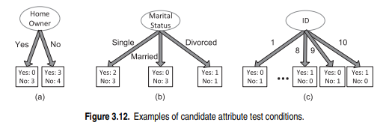
Consider the candidate attribute test condition shown in Figures 3.12(a) and (b) for the loan borrower classification problem

Slide 52
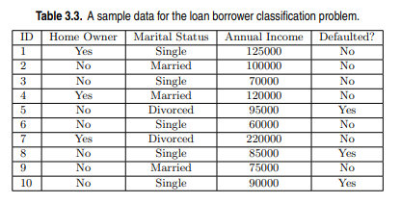

Slide 53
Example of impurity measures

Slide 54
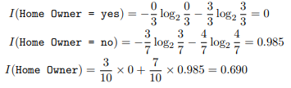
Entropy can be calculated as follows:

Slide 55
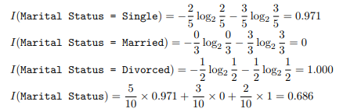
Entropy can be calculated as follows:

Slide 56
Thus, Marital Status has a lower weighted entropy than Home Owner.

Slide 57

To determine how well the test condition performs, we need to compare the degree of impurity of parent node(before splitting) with the degree of impurity of the child node(after splitting)
Larger the difference, better the test condition
Gain is the criteria used to determine the goodness of the split

Slide 58
When entropy is used as the impurity measure, the difference in entropy is commonly known as information gain, Δ_{info}.

Slide 59

Example

Slide 61

The information gains for Home Owner and Marital Status are each given by
The information gain for Marital Status is thus higher due to its lower weighted entropy, which will thus be considered for splitting.

Slide 62

Gain ratio
Used to compensate for attributes that produce a large number of child nodes.
Split info=

Slide 63
Where N(vi) is the number of instances assigned to node vi and k is the total number of splits.

Slide 64
Example:
Consider the data set given
We want to select the best attribute test condition among the following three attributes: Gender, Car Type, and Customer ID.

Slide 65
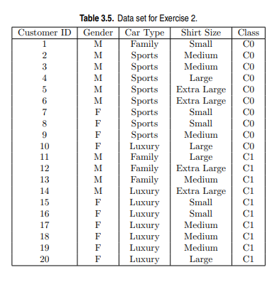

Slide 66


If Gender is used as attribute test condition:

Slide 67
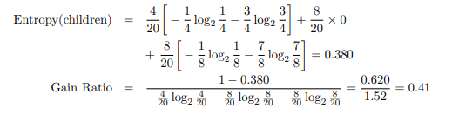
If Car Type is used as attribute test condition:

Slide 68

Finally, if Customer ID is used as attribute test condition:
Thus, even though Customer ID has the highest information gain, its gain ratio is lower than Car Type since it produces a larger number of splits.

Slide 69
Exercises
Consider the training examples shown in Table 3.5 for a binary classification problem.
Compute the Gini index for the overall collection of training examples.
Compute the Gini index for the Customer ID attribute.
Compute the Gini index for the Gender attribute.
Compute the Gini index for the Car Type attribute using multiway split.
Compute the Gini index for the Shirt Size attribute using multiway split.
Which attribute is better, Gender, Car Type, or Shirt Size?
Explain why Customer ID should not be used as the attribute test condition even though it has the lowest Gini.

Slide 71
Example of impurity measures

Slide 72
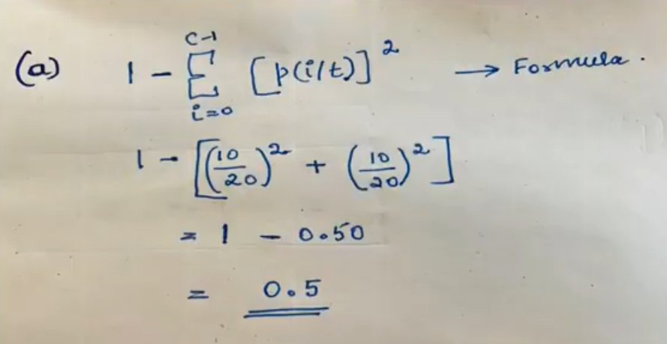
Compute the Gini index for the overall collection of training examples

Slide 73
Compute the Gini index for the Customer ID attribute.
The Gini for each customer ID is zero

Slide 74
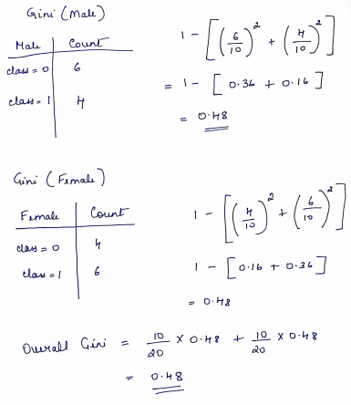
Compute the Gini index for the Gender attribute

Slide 76
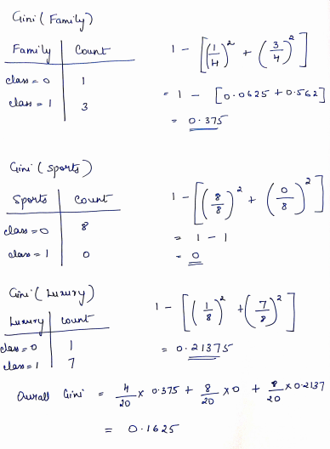
Compute the Gini index for the Car Type attribute using multiway split.

Slide 77
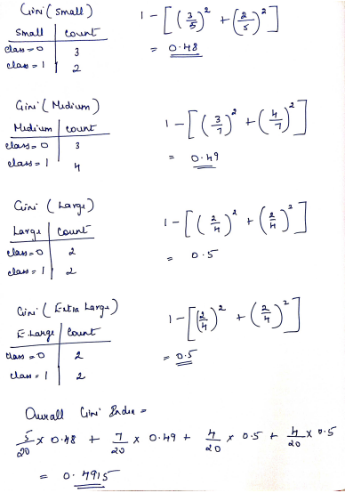
Compute the Gini index for the Shirt Size attribute using multiway split.

Slide 78
Which attribute is better, Gender, Car Type, or Shirt Size?
Car type, because it has the lowest gini compared to the three attributes

Slide 79
Explain why Customer ID should not be used as the attribute test condition even though it has the lowest Gini.
Attribute has no predictive power since the new customers are assigned to the new customer ID’s

Slide 80
Types of Classifiers
Decision tree classifier
Rule based classifier
Nearest Neighbor classifier
Bayesian Classifier

Slide 81
Nearest Neighbor classifier
Uses K- closest points (nearest neighbors) for performing classification

Slide 82
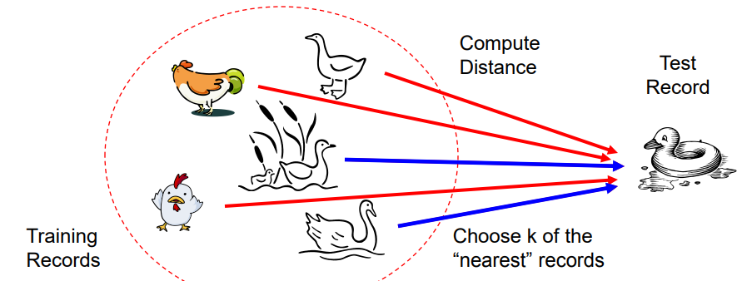
Basic Idea:
If it walks like a duck, quacks like a duck, then its probably a duck

Slide 83
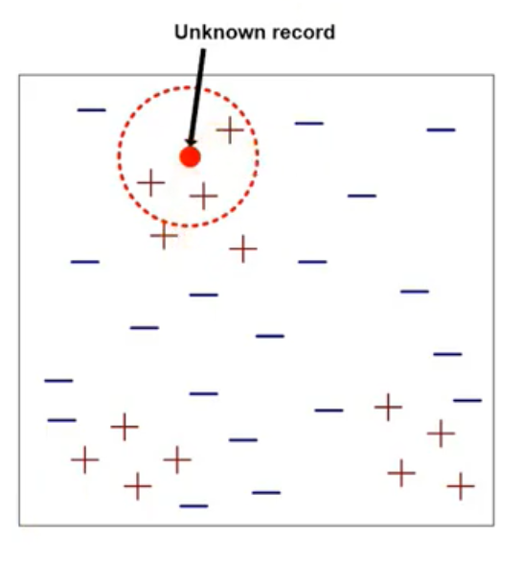

Slide 84
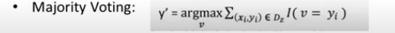
Once the nearest neighbor list is obtained, the test example is classified based on majority class of its nearest neighbour
where, v is a class label
yi is the class label for one of the nearest neighbors
I is an indicator function that returns the value 1 if its argument is true and 0 otherwise.

Slide 85
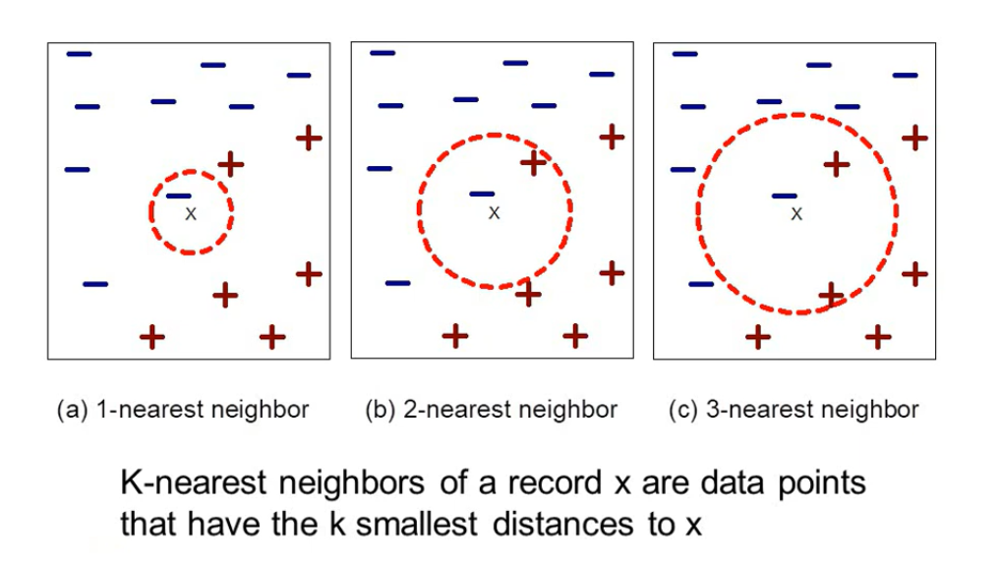

Slide 86
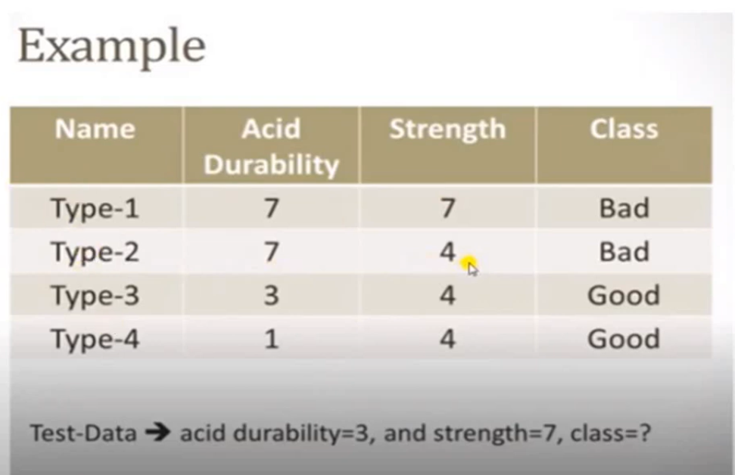

Slide 87
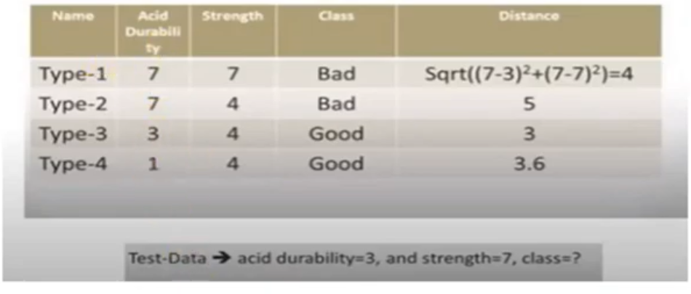

Slide 88
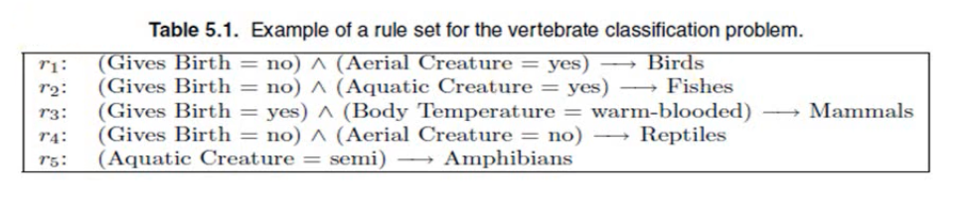
Rule based Classifiers
A rule based classifier is a technique for classifying records using a collection of “if … then …” rules.

Slide 89
Each classification rule can be expressed in the following ways:
r_{i}: (Condition_{i}) → y_{i}
Conditioni= (A1 op v1) ^ (A2 op v2) ^…(Ak op vk)
Where (Aj, vj) is an attribute-value pair and op is a logical operator chosen from the set {=, !=, <, <=, >, >=}

Slide 90
Left hand side of the rule is called the rule antecedent or precondition
Right hand side of the rule is called the rule consequent, which contains the predicted class yi.

Slide 91
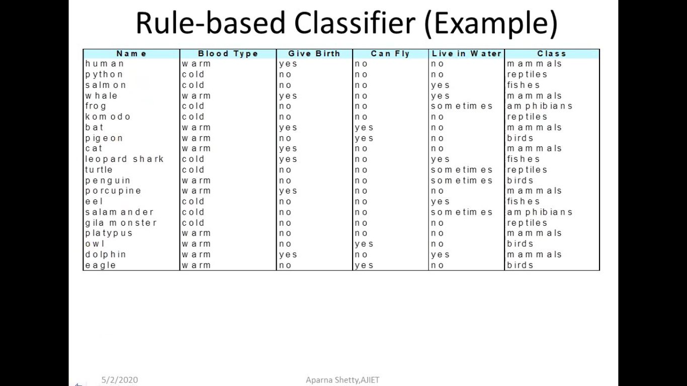
Rule based Classifiers(Example)

Slide 92
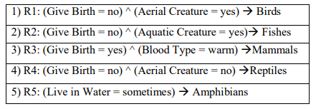

Slide 93
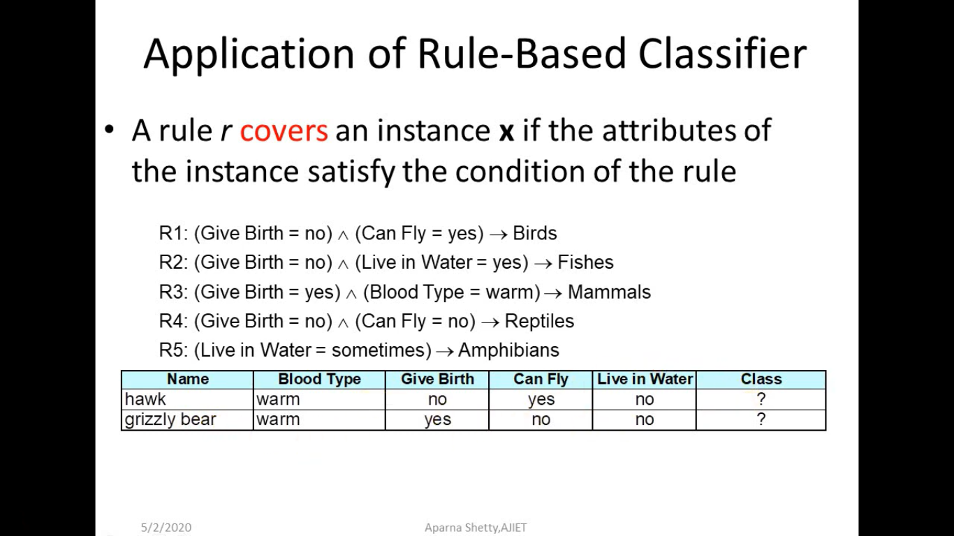
Application of rule based classifier

Slide 94
Rule coverage and accuracy
Coverage of a rule:
Fraction of records satisfy the antecedent of a rule
Accuracy of a rule:
Fraction of records that satisfy the antecedent that also satisfy the consequent of a rule

Slide 95
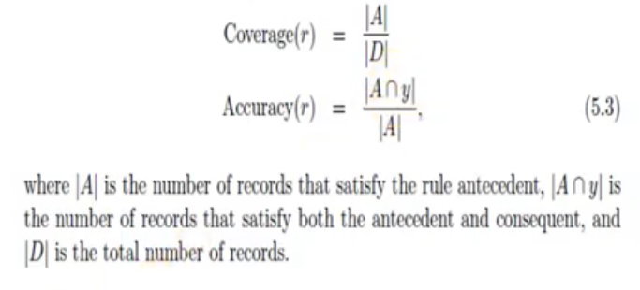

Slide 96
Example
(Status= Single) → No
Coverage=4/10= 40%
Accuracy=2/4=50%

Slide 97
How does a rule based classifier works

Slide 98
Name | Blood type | Skin cover | Gives birth | Lives in water | can fly | Has legs | Hibernate
Lemur | Warm | Fur | Yes | No | No | Yes | Yes
Turtle | Cold | Scales | No | Semi | No | Yes | No
Dogfish shark | cold | scales | Yes | Yes | No | No | no
Lemur triggers rule r3, hence it is classified as a mammal
Turtle triggers both r4 and r5
Dogfish shark triggers none of the rules

Slide 102
Characteristics of decision tree induction
Decision tree induction is a non-parametric approach for building classification models
Finding an optimal decision tree is an NP-complete problem. Many decision tree algorithms employ a heuristic-based approach to guide their search in the vast hypothesis space.
Techniques developed for constructing decision trees are computationally inexpensive, making it possible to quickly construct models even when the training set size is very large.

Slide 103
Decision trees, especially smaller-sized trees, are relatively easy to interpret.
Decision trees provide an expressive representation for learning discrete-valued functions.
Decision tree algorithms are quite robust to the presence of noise, especially when methods for avoiding over-fitting.
The presence of redundant attributes does not adversely affect the accuracy of decision trees

Slide 104
Since most decision tree algorithms employ a top-down, recursive partitioning approach, the number of records becomes smaller as we traverse down the tree.
These algorithm usually employ a greedy strategy that grows a decision tree by making a series of locally optimum decisions about which attribute to use for partitioning the data
Many Algorithms:
-Hunts Algorithm
-CART
-ID3, C4.5
-SLIQ, SPRINT

Slide 108
Types of Classifiers
Decision tree classifier
Rule based classifier
Nearest Neighbor classifier
Bayesian Classifier

Slide 109
Characteristics of a rule set
Mutually Exclusive rules:
- every record is covered by at most one rule
Exhaustive rules
- each record is covered by at least one rules

Slide 110
If the rule set is not exhaustive, then a default rule
Rd: () → yd
Must be added to cover the remaining cases.
If the rule set is not mutually exclusive, there are two ways to overcome the problem
Ordered rules
Unordered rules

Slide 111
Ordered rules
Rules in rule set are ordered in decreasing order of their priority
Based on accuracy, coverage, or order in which the rules are generated
This avoids the problem of conflicting classes predicted by multiple classification rules

Slide 112
Unordered rules
This approach will allow a test record to trigger multiple classification rules and considers the consequent of each rule as a vote for a particular class.
The votes are tallied to determine the class label of the test record
The record is usually assigned to the class that receives highest number of votes

Slide 113
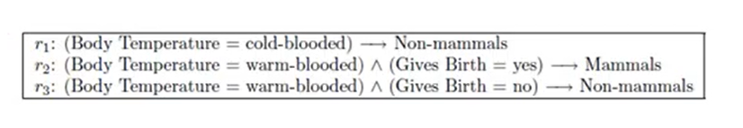
Example

Slide 114
Rule Ordering Scheme
Rule based ordering
Class based ordering

Slide 115
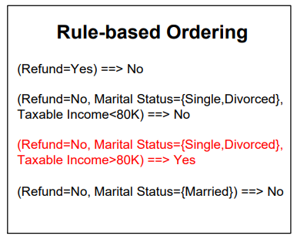

Slide 116
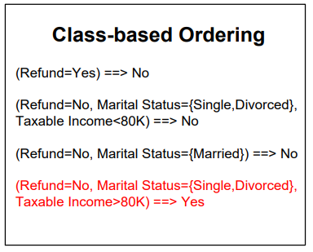

Slide 117
Rule based ordering:
Individual rules are ranked based on their quality
Class based ordering:
Rules that belong to same class appear together

Slide 118
Direct method (Sequential covering)
Example:
For the vertebrate classification problem, the sequential covering algorithm may generate rules for classifying birds first, followed by rules for classifying mammals, amphibians, reptiles, and finally, fishes

Slide 120
Sequential Covering Algorithm steps:
1. Start from an empty rule
2. Grow a rule for a record
3. Remove training records covered by the rule
4. Repeat Step (2) and (3) until stopping criterion is met

Slide 121
Rule based Classifiers(Example)

Slide 123
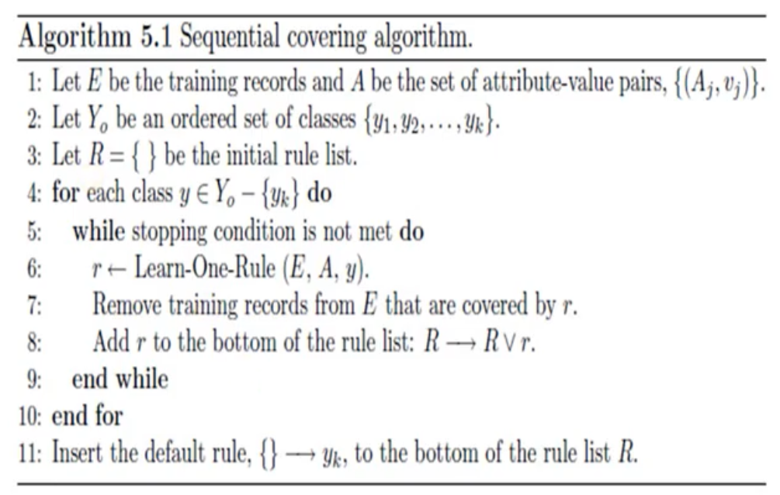

Slide 124
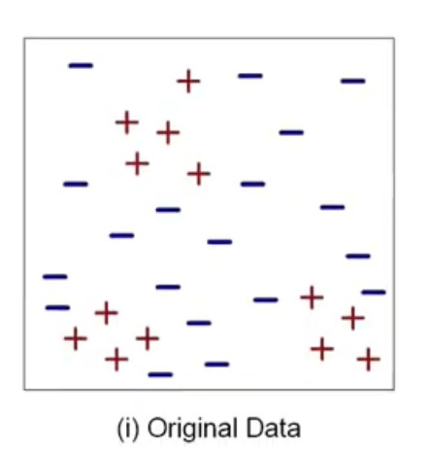
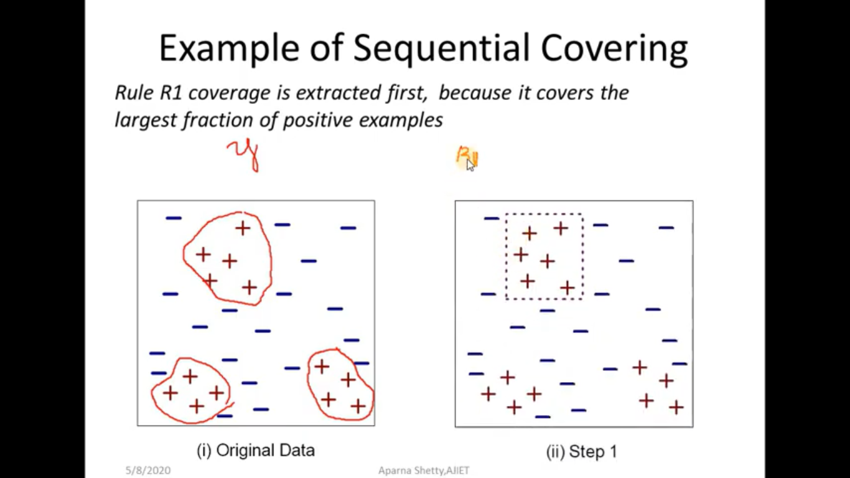
Example of Sequential covering

Slide 125
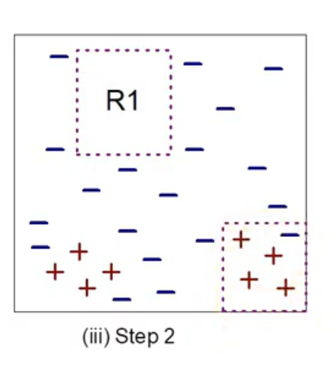
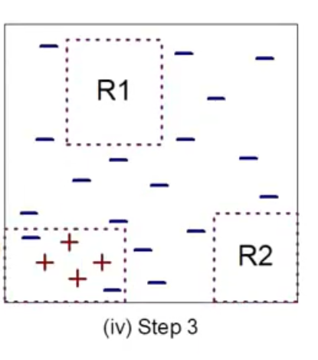

Slide 127
Rule growing
Two common strategies:
General-to-Specific
Specific-to-General

Slide 128
General-to-Specific
An initial rule is created
r: () → y
Where left hand side is an empty set
The rule has poor quality because it covers all the records in training set
New conjuncts are subsequently added to improve the rules quality

Slide 129

Example: Vertebrate classification problem

Slide 131

Specific-to-General

Slide 132
How to build a Rule Based Classifier
There are two broad classes of methods for extracting classification rules:
Direct method, which extract classification rules directly from data
Indirect method, which extract classification rules from other classification models, such as decision trees and neural networks

Slide 133
Indirect method
Generating a rule set from decision tree

Slide 134


Slide 135

From decision Trees to rules

Slide 136


Slide 137
Advantages of rule based classifiers
As highly expressive as decision tree
Easy to interpret
Easy to generate
Can classify new instances rapidly
Performance comparable to decision tree

Slide 138
Types of Classifiers
Decision tree classifier
Rule based classifier
Nearest Neighbor classifier
Bayesian Classifier

Slide 139


Slide 140


Slide 142
Once the nearest neighbor list is obtained, the test example is classified based on majority class of its nearest neighbour
where, v is a class label
yi is the class label for one of the nearest neighbors
I is an indicator function that returns the value 1 if its argument is true and 0 otherwise.

Slide 144
Types of Classifiers
Decision tree classifier
Rule based classifier
Nearest Neighbor classifier
Bayesian Classifier

Slide 145
Bayesian classifiers
Let X and Y be a pair of random variables
Their,
Joint probability, P(X=x, Y=y) refers to the probability that variable X will take on the value x and variable Y will take on the value y.
Conditional probability, P(Y=y | X=x) refers to the probability that the variable Y will take on the value y, given that the variable X is observed to have the value x

Slide 146

Formula of Bayes theorem

Slide 147
P(Y|X) = Posterior probability for Y
P(Y) = Prior Probability
P(X|Y) = class conditional probability
P(X)= total probability

Slide 148
Using Bayes theorem for classification

Slide 149


Slide 150

Suppose any test tuple comes with
marital status= married we need to classify them as defaulted borrower = yes or defaulted borrower= no
P(Defaulted borrower=No| marital status = married)
➔$\frac{\begin{aligned}P\left(marital status=married | default borrower=No\right)X \\ P(default borrower=No)\end{aligned}}{P(marital status=married)}$
➔$\frac{4/7X 7/10}{4/10}$= 1.00

Slide 151

P(Defaulted borrower=Yes| marital status = married)
➔$\frac{\begin{aligned}P\left(marital status=married | default borrower=yes\right)X \\ P(default borrower=yes)\end{aligned}}{P(marital status=married)}$
➔$\frac{0/3X 3/10}{4/10}$= 0

Slide 152
Conclusion:
Since P(Defaulted borrower=No| marital status = married) > P(Defaulted borrower=Yes| marital status = married)
The test tuple with attribute marital status=married is classified as default borrower=No

Slide 153

Naive Bayes classifier
A naive Bayes classifier estimates the class-conditional probability by assuming that the attributes are conditionally independent.

Slide 154


Slide 156


Slide 157


Slide 158


Slide 159
Estimating predictive accuracy of classification method
The accuracy of a classification method is the ability of the method to correctly determine the class of a randomly selected data.

Slide 160
The following are the different methods for estimating the accuracy of a method.
Holdout method(Test sample method):
In this method, the given data are randomly partitioned into two independent sets, a training set and a test set. Typically, two-thirds of the data are allocated to the training set, and the remaining one-third is allocated to the test set. The training set is used to derive the model. The model’s accuracy is then estimated with the test set

Slide 161


Slide 162
Random sub-sampling method:
Random subsampling is a variation of the holdout method in which the holdout method is repeated k times.
The overall accuracy estimate is taken as the average of the accuracies obtained from each iteration.

Slide 163
K-fold cross validation method:
Training and testing is performed k times.
In the first iteration, subsets D2, … , Dk collectively serve as the training set to obtain a first model, which is tested on D1; the second iteration is trained on subsets D1, D3, … , Dk and tested on D2; and so on.
The accuracy estimate is the overall number of correct classifications from the k iterations, divided by the total number of tuples in the initial data.

Slide 164
Boot strap method:
In this method, given a data set of size n a bootstrap sample is randomly selected uniformly with replacement(a sample may be selected more than once) and build a model.

Slide 165
Other evaluation criteria for classification methods
Speed:
Speed involves not just the time or computation cost of constructing a model it also includes the time required to learn to use the model.
Robustness:
Even if there are some data error, the classification method should be able to produce good results.

Slide 166

Scalability:
As the data set increases the method should work efficiently for large data bases
Flexibility:
Flexible enough for small modifications on the training data set
Time complexity:
Should not be exponential nor factorial. It should be in terms of log or linear or $N^{2}$

Slide 167
Interpretability
It is desirable that the end-user be able to understand and gain insight from the results produced by the classification method

